Slide 1


GAC, PAC, and the Legislative Symposium

Slide 2
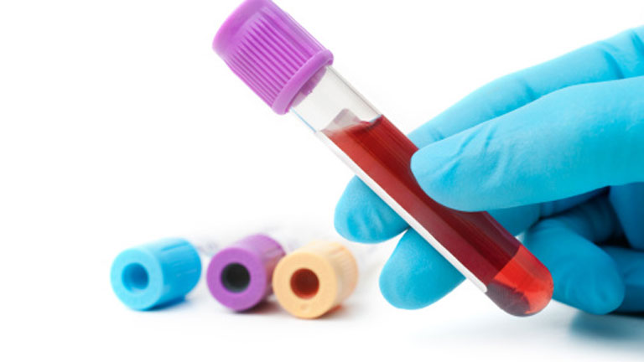
ASCLS: One Voice, One Vision
ASCLS has a clear vision for our profession
  Laboratory tests that are safe, accurate, timely, appropriate and cost effective
  Competent laboratory professionals
But just knowing that is not enough
Our “Voice” is what allows this vision to become a reality
Notes:
One of the Key elements of our mission/ vision statement

Slide 3

What do we mean by being
“The Voice”
Being the voice can be as simple as:
  Talking to a friend or family member about what you do
  Sharing a laboratory-profession related article on social media
  Giving a career day presentation
Sometimes being “the voice” is more complicated
  Especially when it comes to government affairs

Slide 4
Government Affairs?
Government Affairs deals with an organization’s interactions with the legislative branch (Congress) and regulatory agencies
It seems impossible at first to think a laboratory organization would need to interact with the government, but regardless of whether we are working the bench or a laboratory manager we are affected everyday by laws and regulations made by the government

Slide 5




Government’s Impact on Laboratories
Congress can pass legislation that impacts laboratories
Federal Agencies can publish regulations that impact laboratories

Slide 6
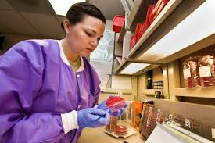

Laws and regulations affecting the laboratory are supposed to be beneficial to both the laboratory and our patients, but it doesn’t always work out that way
  As laboratory professionals we need to use our “voice” to educate those in government so they can make informed decisions
Unfortunately, we “don’t speak the same language”, so we need a translator

Slide 7
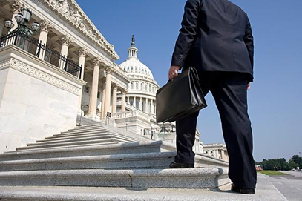
Lobbyists Are Our Translators
An activist who works to persuade members of government to enact legislation that would be beneficial to their group is known as a lobbyist
Lobbying involves
  Raising awareness and persuading legislators
  Researching and analyzing legislation or regulatory proposals
  Attending congressional hearings
  Educating government officials

Slide 8

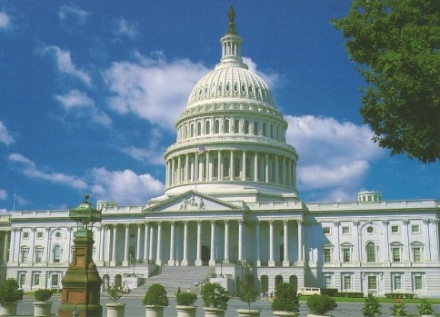



ASCLS Government Affairs Committee (GAC)
ASCLS works with legislative consultants from The Federal Group in Washington, D.C.
The Federal Group keeps a constant eye on laboratory legislation and lobbies on behalf of ASCLS
On the GAC conference calls , our legislative consultant updates the committee on the current issues on Capitol Hill. The committee is free to ask questions and raise concerns
GAC passes this information on to all ASCLS members through ASCLS Today articles, GAC Newsletters, Action Items, and through committee liaisons to each of the ASCLS Regional President's Councils
Members pass this information on to non-members and their community by word of mouth or social media

Slide 9

So that’s GAC, now what about PAC?

Slide 10
What is a Political Action Committee (PAC)?
A committee formed by business, labor or other special-interest groups to raise money and make contributions to the campaigns of political candidates whom they support.
All PACs are legal, ethical, and strictly regulated by federal law.

Slide 11

ASCLS/PAC
ASCLS has had a PAC since 1976 and is the ONLY Laboratory Professional Society with an active PAC!
Our PAC offers members a simple way to influence the election process. Donated funds allow members to collectively gain the attention of candidates for national political offices.

Slide 12

Where do ASCLS/PAC donations go?
PAC Donations are used to:
  Contribute to members of Congress who understand the importance of OUR profession and are strong proponents of our profession
  Support the Legislative Symposium
  Give our legislative consultants a seat at the table (both literally and figuratively)

Slide 13
How ASCLS/PAC works
There are different types of PACs, but ASCLS/PAC is considered a Separate Segregated Fund (SSF)
SSF’s can ONLY directly solicit from members for donations, but are allowed to accept voluntary donations from anyone
  Wait…What does that mean??

Slide 14
Examples of Direct vs. Indirect Solicitations
Direct:
  Your friend on the ASCLS/PAC committee is allowed to ask you directly if you (an ASCLS member) want to donate to PAC
Indirect:
  Your friend at work is a NOT a member of ASCLS, so you cannot ask them directly if they want to donate. However, your friend can still make a donation of their own freewill.

Slide 15
Other things to know about PAC donations
No money from member dues is given to PAC
Donations must be voluntary and are not tax deductible
Contributors will be asked to fill out a form with your name, address and donation amount
  If you donate >$200 within one year you must also disclose your employer
Each individual may donate up to $5,000 to PAC each calendar year, but any amount helps!

Slide 16

GAC and PAC Together
GAC and PAC are two huge benefits of membership
Gaining and retaining members is important because PAC can then solicit donations from a larger pool of people and GAC can have a louder voice.

Slide 17
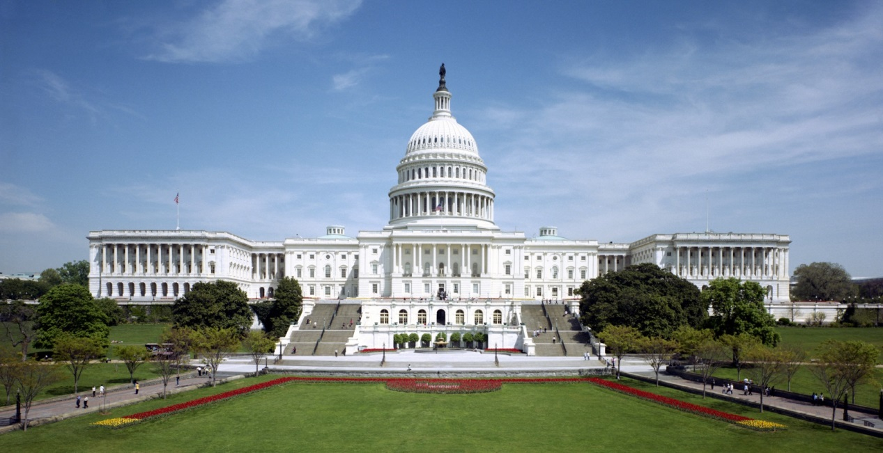
Legislative Symposium

Slide 18
Legislative Symposium
Often called “Leg Day” (pronounced ledge-day) by members
Held every year in March in collaboration with CLMA, ASCP, AGT, and AMT
Provides members from each state with a platform to take to their Congressional leaders on the same day. This allows one visible and unified voice from the laboratory profession

Slide 19
What to expect at the Legislative Symposium
Day 1- Host hotel
  Overview of Congressional Environment
  Briefings on different legislative issues facing the laboratory
  Education on how congressional offices work and how to communicate our message effectively
  Opportunities to network with fellow laboratory professionals
  Opportunity to visit the PAC table to make a donation
Day 2- Capitol Hill
  Travel to Capitol Hill to attend pre-made appointments with the offices of your Senators and Congressperson

Slide 20
Some Tips for a Successful Leg Day
Start making appointments about a month in advance
Don’t be disappointed if you don’t get an appointment to speak directly to the Senator/Congressperson. Staffers are often better to speak with as they are the ones doing all the research on specific issues
Don’t be afraid to ask questions during the symposium. The material can get confusing at times, so if you have questions it’s likely others have the same ones.
Remember, between you and the staffer you speak with, you’re the one that knows the laboratory best. Be confident in what you have to say.

Slide 21
I can’t attend Leg Day! What can I do to help?
Remember EVERY VOICE MATTERS. Leg day is a great experience, but if you can’t attend, there are many ways you can still use your voice.
  Call or email your Senators/Congressperson and discuss some of the issues the laboratory is facing
  Visit your Senators’/Congressperson’s local offices
    Have your own mini Leg Day with members of your state
  Take advantage of any action items that GAC sends out and share them on social media to help spread the word
  Donate to PAC

Slide 22
Interested in learning more?
http://dc.about.com/od/jobs/a/Lobbying.htm
http://www.differencebetween.net/miscellaneous/difference-between-legislation-and-regulation/
https://www.usa.gov/elected-officials
http://federalgrp.com/
http://uspolitics.about.com/od/finance/a/what_is_a_PAC.htm
http://www.fec.gov/ans/answers_pac.shtml
http://www.ascls.org/advocacy-issues/pac
http://www.ascls.org/education-meetings/legislative-symposium

